Slide 1
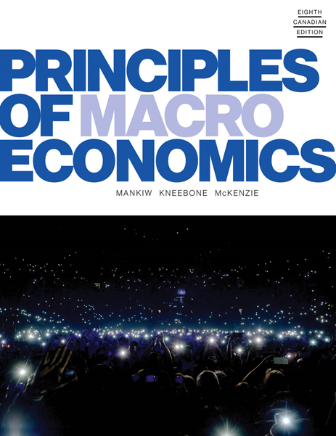
Principles of Macroeconomics
Eighth Canadian Edition
by Mankiw/Kneebone/McKenzie
Adapted for the Eighth Canadian Edition by Marc Prud’Homme University of Ottawa

Slide 2

Chapter 11
MONEY GROWTH AND INFLATION

Slide 3
MONEY GROWTH AND INFLATION (1 of 2)
What determines whether an economy experiences inflation and, if so, how much?
Inflation is an increase in the overall level of prices.
Deflation is a fall in the overall level of prices.

Slide 4
MONEY GROWTH AND INFLATION (2 of 2)
The inflation rate is the percentage change in either the:
C P I
G D P deflator
Other index of the overall price level
These price indexes show that, over the past 70 years, prices have risen on average about 4 percent per year.
Accumulated over so many years, a 4 percent annual inflation rate leads to a 16-fold increase in the price level.
Notes:
What determines whether an economy experiences inflation and, if so, how much?
This chapter answers this question by developing the quantity theory of money.
After developing a theory of inflation, we turn to a related question: Why is inflation a problem?

Slide 5
THE CLASSICAL THEORY OF INFLATION (1 of 13)
The quantity theory of money will be used to understand inflation.
It is often called classical because it was developed by some of the earliest thinkers about economic issues.
Notes:
Most economists today rely on this theory to explain the long-run determinants of the price level and the inflation rate.

Slide 6
THE CLASSICAL THEORY OF INFLATION (2 of 13)
The Level of Prices and the Value of Money
The economy’s overall price level can be viewed in two ways:
As the price of a basket of goods and services.
As a measure of the value of money.
Notes:
The first insight about inflation is that it is more about the value of money than about the value of goods.
This insight helps point the way toward a theory of inflation. When the consumer price index and other measures of the price level rise, commentators are often tempted to look at the many individual prices that make up these price indexes: “The CPI rose by 3% last month, led by a 20% rise in the price of coffee and a 30% rise in the price of heating oil.”
Although this approach does contain some interesting information about what’s happening in the economy, it also misses a key point: Inflation is an economy-wide phenomenon that concerns, first and foremost, the value of the economy’s medium of exchange.

Slide 7
THE CLASSICAL THEORY OF INFLATION (3 of 13)
Money Supply, Money Demand, and Monetary Equilibrium
The value of money is determined by the supply and demand for money.
The supply of money is controlled by the Bank of Canada and the banking system.
The demand for money reflects how much people will want to hold in liquid form.
The demand for money is sometimes referred to as “liquidity preference.”

Slide 8
THE CLASSICAL THEORY OF INFLATION (4 of 13)
Money Supply, Money Demand, and Monetary Equilibrium
Many factors affect the demand for money.
For example, the amount of currency that people hold in their wallets can depend on how much they rely on credit cards or the accessibility of ATMs.
The most important variable that explains the demand for money is the level of prices in the economy.
In the long run, the overall level of prices adjusts to the level at which demand for money equals the supply.
Notes:
Many factors influence the quantity of money demanded—or, if you like, the preference for holding wealth in liquid form.
The amount of currency that people hold in their wallets, for instance, depends on how much they rely on credit cards and on whether an ATM is easy to find.
And, as we will emphasize in Chapter 15, the quantity of money demanded depends on the interest rate that a person could earn by using the money to buy an interest-bearing bond rather than leaving it in a wallet or low-interest chequing account.
Later in the book, it will be explained that interest rates play a key role in explaining short-run equilibrium in the money market.

Slide 9
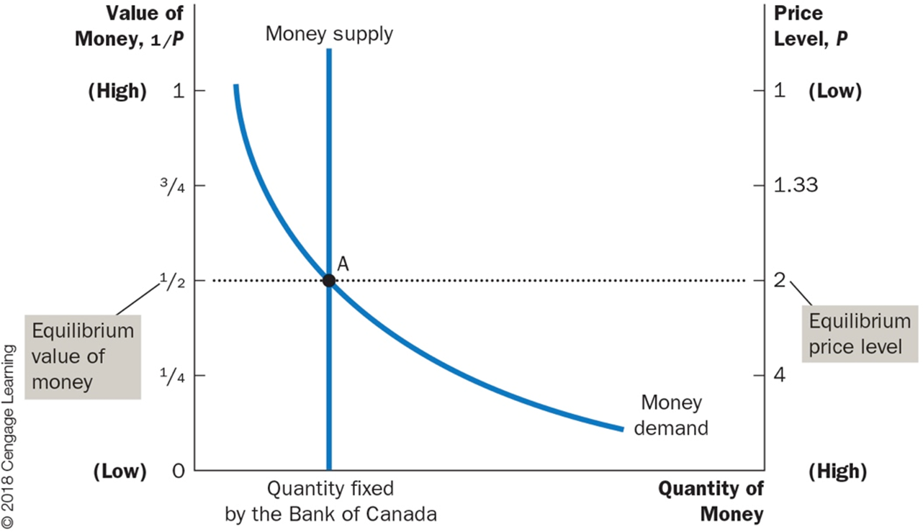
FIGURE 11.1: How the Supply and Demand for Money Determine the Equilibrium Price Level
Notes:
The horizontal axis shows the quantity of money.
The left vertical axis shows the value of money, and the right vertical axis shows the price level.
The supply curve for money is vertical because the quantity of money supplied is fixed by the Bank of Canada.
The demand curve for money is downward-sloping because people want to hold a larger quantity of money when each dollar buys less.
At the equilibrium, point A, the value of money (on the left axis) and the price level (on the right axis) have adjusted to bring the quantity of money supplied and the quantity of money demanded into balance.

Slide 10
THE CLASSICAL THEORY OF INFLATION (5 of 13)
The Effects of a Monetary Injection
What are the effects of a change in monetary policy?
Imagine the B o C doubles the supply of money by printing some dollar bills and dropping them around the country from helicopters.
What happens after such a monetary injection?
How does the new equilibrium compare to the old one?

Slide 11
THE CLASSICAL THEORY OF INFLATION (6 of 13)
The Effects of a Monetary Injection
This explanation of how the price level is determined and why it might change over time is called the quantity theory of money.
Quantity theory of money is a theory asserting that the quantity of money available determines the price level and that the growth rate in the quantity of money available determines the inflation rate.

Slide 12
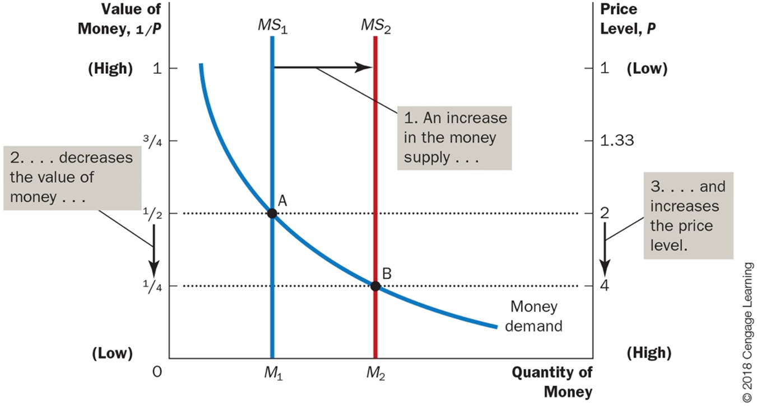
FIGURE 11.2: An Increase in the Money Supply
Notes:
When the Bank of Canada increases the supply of money, the money supply curve shifts from MS₁ to MS₂.
The value of money (on the left axis) and the price level (on the right axis) adjust to bring supply and demand back into balance.
The equilibrium moves from point A to point B.
Thus, when an increase in the money supply makes dollars more plentiful, the price level increases, making each dollar less valuable.

Slide 13
THE CLASSICAL THEORY OF INFLATION (7 of 13)
The Classical Dichotomy and Monetary Neutrality
Economic variables can be divided into two groups:
Nominal variables are variables measured in monetary units.
Real variables are variables measured in physical units.
Classical dichotomy: The theoretical separation of nominal and real variables.
Monetary neutrality is the proposition that changes in the money supply do not affect real variables.
Notes:
Application of the classical dichotomy is somewhat tricky when we turn to prices.
Prices in the economy are normally quoted in terms of money and, therefore, are nominal variables.
For instance, when we say that the price of corn is $200 per tonne or that the price of wheat is $100 per tonne, both prices are nominal variables.
But what about a relative price—the price of one thing compared to another? In our example, we could say that the price of a tonne of corn is two tonnes of wheat.
Notice that this relative price is no longer measured in terms of money.
When comparing the prices of any two goods, the dollar signs cancel, and the resulting number is measured in physical units. The lesson is that dollar prices are nominal variables, whereas relative prices are real variables.
This lesson has several important applications. For instance, the real wage (the dollar wage adjusted for inflation) is a real variable because it measures the rate at which the economy exchanges goods and services for each unit of labour.
Similarly, the real interest rate (the nominal interest rate adjusted for inflation) is a real variable because it measures the rate at which the economy exchanges goods and services produced today for goods and services produced in the future.
Why bother separating variables into these two groups?
The classical dichotomy is useful in analyzing the economy because different forces influence real and nominal variables.
In particular, nominal variables are heavily influenced by developments in the economy’s monetary system, whereas in the long run, the quantity of money is largely irrelevant for understanding the determinants of important real variables.
Changes in the supply of money, according to classical analysis, affect nominal variables but not real variables.
When the central bank doubles the money supply, the price level doubles, the dollar wage doubles, and all other dollar values double.
Real variables, such as production, employment, real wages, and real interest rates, are unchanged.
This irrelevance of monetary changes for real variables in the long run is called monetary neutrality.

Slide 14

THE CLASSICAL THEORY OF INFLATION (8 of 13)
Velocity and the Quantity Equation
How many times per year is the typical dollar used to pay for a newly produced good or service?
Velocity of money is the rate at which money changes hands.
V: Velocity of money
Y: Real G D P
P: Price level
M: Quantity of money
Notes:
We can obtain another perspective on the quantity theory of money by considering the following question: how many times per year is the typical dollar used to pay for a newly produced good or service?
The concept of the velocity of money will help answer this question.
To calculate the velocity of money, we divide the nominal value of output (nominal GDP) by the quantity of money.
If P is the price level (the GDP deflator), Y the quantity of output (real GDP), and M the quantity of money, then velocity is (see above).
Let’s imagine a simple economy that produces only pizza. Suppose that the economy produces 100 pizzas in a year, the pizzas sell for $10, and that the quantity of money in the economy is $50.
Then V = (10 × 100)/50 = 20
In this economy people spend a total of $1000 per year on pizza.
For this $1000 of spending to take place with only $50 of money, each dollar must change hands on average 20 times per year.

Slide 15
THE CLASSICAL THEORY OF INFLATION (9 of 13)
Velocity and the Quantity Equation
Quantity equation is the equation that relates the quantity of money, the velocity of money, and the dollar value of the economy’s output of goods and services.
M × V = P × Y
Notes:
We can obtain another perspective on the quantity theory of money by considering the following question: how many times per year is the typical dollar used to pay for a newly produced good or service?
The concept of the velocity of money will help answer this question.
To calculate the velocity of money, we divide the nominal value of output (nominal GDP) by the quantity of money.
If P is the price level (the GDP deflator), Y the quantity of output (real GDP), and M the quantity of money, then velocity is (see above).
Let’s imagine a simple economy that produces only pizza. Suppose that the economy produces 100 pizzas in a year, the pizzas sell for $10, and that the quantity of money in the economy is $50.
Then V = (10 × 100)/50 = 20
In this economy people spend a total of $1000 per year on pizza.
For this $1000 of spending to take place with only $50 of money, each dollar must change hands on average 20 times per year.

Slide 16
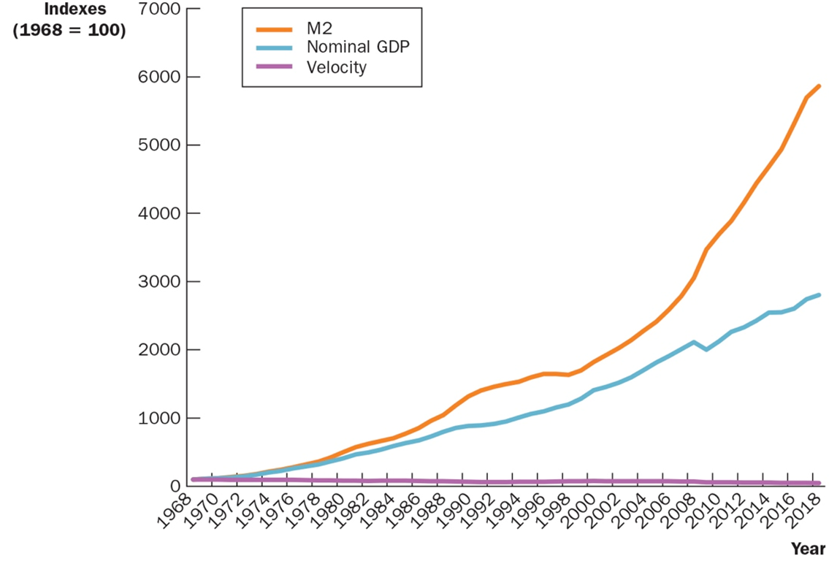
FIGURE 11.3: Nominal G D P, the Quantity of Money, and the Velocity of Money
Sources: Statistics Canada, C A N S I M database and authors’ calculations.
Notes:
This figure shows the nominal value of output as measured by nominal GDP, the quantity of money as measured by M2, and the velocity of money as measured by their ratio.
For comparability, all three series have been scaled to equal 100 in 1968. Notice that nominal GDP and the quantity of money have grown dramatically over this period, while velocity has been relatively stable.
The recession of 2009 is apparent in the fall in the value of GDP in that year.

Slide 17
THE CLASSICAL THEORY OF INFLATION (10 of 13)
Velocity and the Quantity Equation
The elements for explaining the equilibrium price level:
Velocity (V) is stable over time.
Because V is stable, when the central bank changes the quantity of money (M), it causes proportionate changes in the nominal value of output (P × Y).
The economy’s output of goods and services (Y) is primarily determined by factor supplies and technology. In particular, because money is neutral, money does not affect output.

Slide 18
THE CLASSICAL THEORY OF INFLATION (11 of 13)
Velocity and the Quantity Equation
With output (Y) determined by factor supplies and technology, when the central bank alters the money supply (M) and induces proportional changes in the nominal value of output (P × Y), these changes are reflected in changes in the price level.
Therefore, when the central bank increases the money supply rapidly, the result is a high rate of inflation.
Notes:
These five steps are the essence of the quantity theory of money.

Slide 19
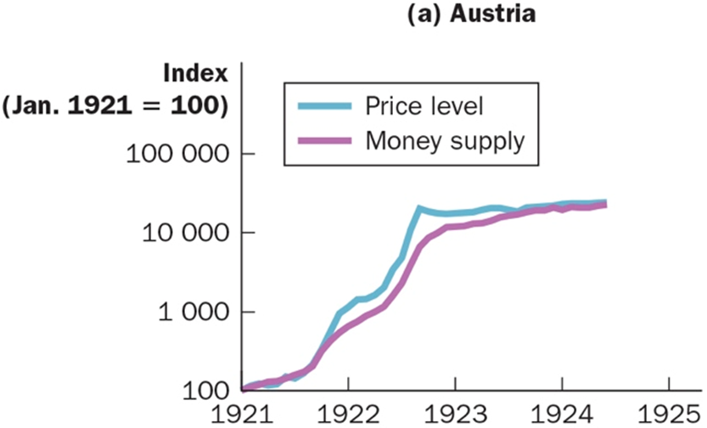
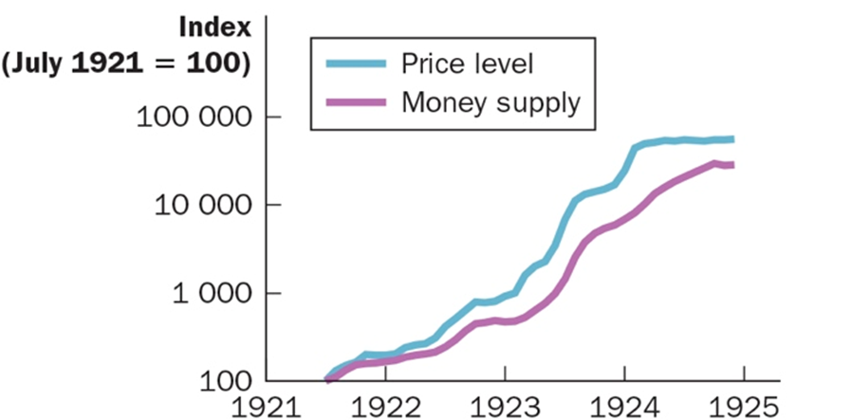
FIGURE 11.4: Money and Prices during Four Hyperinflations (1 of 2)
(a) Austria
(b) Hungary
Sources for Austria, Hungary, Germany, and Poland: © 2018 Cengage Learning. Adapted from Thomas J. Sargent, “The End of Four Big Inflations,” in Robert Hall, ed., Inflation (Chicago: University of Chicago Press, 1983), pp. 41-93.
Notes:
This figure shows the quantity of money and the price level during four hyperinflations. (Note that these variables are graphed on logarithmic scales.)
This means that equal vertical distances on the graph represent equal percentage changes in the variable.) In each case, the quantity of money and the price level move closely together.
The strong association between these two variables is consistent with the quantity theory of money, which states that growth in the money supply is the primary cause of inflation.
Video: Zimbabwe Super Hyper Inflation
https://youtu.be/78-BlZXm7wA

Slide 20
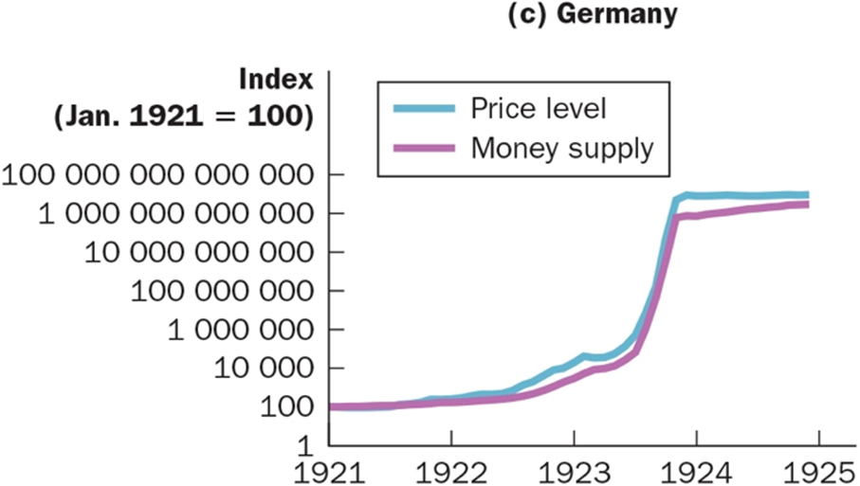
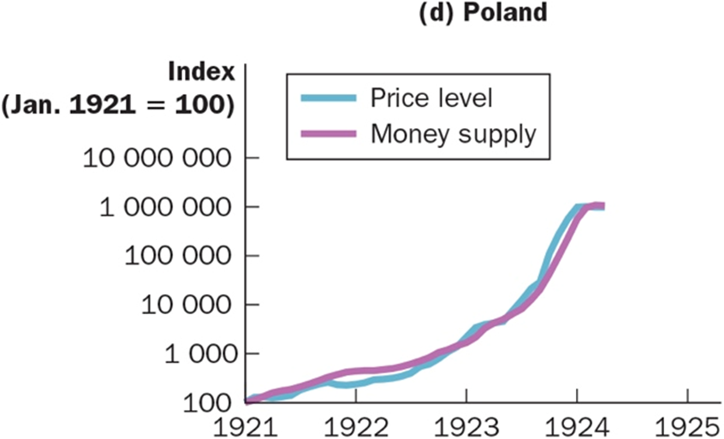
FIGURE 11.4: Money and Prices during Four Hyperinflations (2 of 2)
(c) Germany
(d) Poland
Notes:
This figure shows the quantity of money and the price level during four hyperinflations. (Note that these variables are graphed on logarithmic scales.)
This means that equal vertical distances on the graph represent equal percentage changes in the variable.) In each case, the quantity of money and the price level move closely together.
The strong association between these two variables is consistent with the quantity theory of money, which states that growth in the money supply is the primary cause of inflation.
Video: Zimbabwe Super Hyper Inflation
https://youtu.be/78-BlZXm7wA

Slide 21
THE CLASSICAL THEORY OF INFLATION (12 of 13)
The Inflation Tax
Inflation tax is the revenue the government raises by creating money.
The inflation tax is not exactly like other taxes, however, because no one receives a bill from the government for this tax. The inflation tax is more subtle.
When the government prints money, the price level rises, and the dollars in your pocket are less valuable.
Notes:
When the government raises revenue by printing money, it is said to levy an inflation tax.
Typically the government has high spending, inadequate tax revenue, and limited ability to borrow. As a result it turns to the printing press to pay for its spending.
This massive increase in the quantity of money leads to hyperinflation.
The inflation ends when the government institutes fiscal reforms, such as a cut in government spending, that eliminate the need for the inflation tax.

Slide 22
THE CLASSICAL THEORY OF INFLATION (13 of 13)
The Fisher Effect
Real interest rate = Nominal interest rate − Inflation rate
Nominal interest rate = Real interest rate + Inflation rate
Fisher effect is the one-for-one adjustment of the nominal interest rate to the inflation rate.
Notes:
According to the principle of monetary neutrality, an increase in the rate of money growth raises the rate of inflation but does not affect any real variable.
An important application of this principle concerns the effect of money on interest rates.
To understand the relationship among money, inflation, and interest rates, recall the distinction between the nominal interest rate and the real interest rate.
The relationship between the nominal interest rate, the real interest rate, and the inflation rate are shown in the above two equations.
Let us now examine how the growth in the money supply affects interest rates.
When the Bank of Canada increases the rate of money growth, the result is both a higher inflation rate and a higher nominal interest rate.
This adjustment of the nominal interest rate to the inflation rate is called the Fisher effect.
Note that the Fisher effect is a long-run effect, it does not hold in the short run.

Slide 23
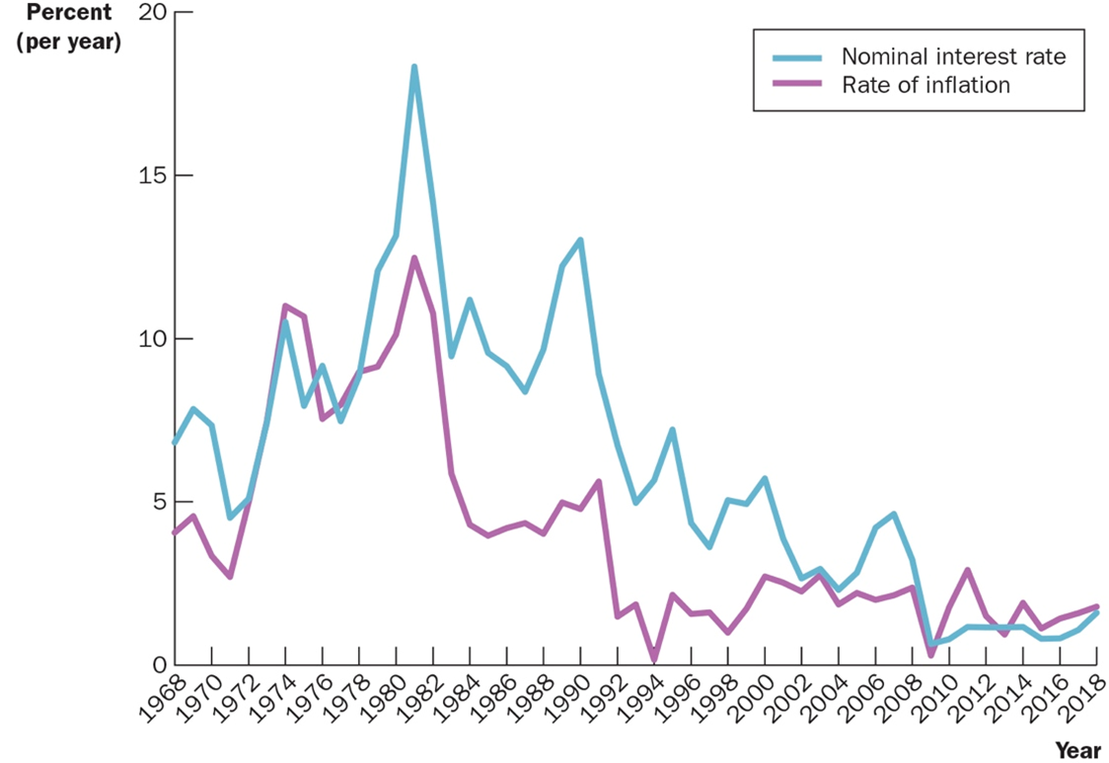
FIGURE 11.5: The Nominal Interest Rate and the Inflation Rate
Sources: Statistics Canada, C A N S I M database.
Notes:
This figure uses annual data since 1968 to show the nominal interest rate on three-month corporate bonds and the inflation rate as measured by the consumer price index.
The close association between these two variables over the long run is evidence for the Fisher effect: When the inflation rate rises, so does the nominal interest rate.

Slide 24
Quick Quiz 1
The government of a country increases the growth rate of the money supply from 5 percent per year to 50 percent per year.
What happens to prices?
What happens to nominal interest rate
Why might the government be doing this?

Slide 25
THE COSTS OF INFLATION (1 of 8)
Inflation is closely watched and widely discussed because it is thought to be a serious economic problem.
True?
Why?

Slide 26
THE COSTS OF INFLATION (2 of 8)
A Fall in Purchasing Power? The Inflation Fallacy
Inflation does not in itself reduce people’s real purchasing power.
If nominal incomes tend to keep pace with rising prices, inflation is not a problem.
There are, however, costs associated with inflation.

Slide 27
THE COSTS OF INFLATION (3 of 8)
Shoeleather Costs
Shoeleather costs are the resources wasted when inflation encourages people to reduce their money holdings.
Menu Costs
Menu costs are the costs of changing prices.
Notes:
Firms change prices infrequently because there are costs of changing prices.
Costs of price adjustment are called menu costs, a term derived from a restaurant’s cost of printing a new menu.
Menu costs include the cost of deciding on new prices, the cost of printing new price lists and catalogues, the cost of sending these new price lists and catalogues to dealers and customers, the cost of advertising the new prices, and even the cost of dealing with customer annoyance over price changes.

Slide 28
THE COSTS OF INFLATION (4 of 8)
Relative-Price Variability and the Misallocation of Resources
Because prices change only once in a while, inflation causes relative prices to vary more than they otherwise would.
This issue is important because in market economies, we rely on relative prices to allocate scarce resources.
Notes:
Consumers decide what to buy by comparing the prices of various goods and services.
Rarely do consumers look at individual prices when making their purchasing decisions, but more likely they compare the price of an item to the price of a comparable item when making a purchase.
When relative prices are distorted because of inflation, consumer decisions are also distorted and markets are less able to allocate resources to their best use.

Slide 29
THE COSTS OF INFLATION (5 of 8)
Inflation-Induced Tax Distortions
Inflation tends to raise the tax burden on income earned from savings.
Inflation discourages saving is the tax treatment of capital gains.
The income tax treats the nominal interest earned on savings as income, even though part of the nominal interest rate merely compensates for inflation.

Slide 30
TABLE 11.1: How Inflation Raises the Tax Burden on Saving
 | Economy A (price stability) | Economy B (inflation)
Real interest rate | 4% | 4%
Inflation rate | 0 | 8
Nominal interest rate (real interest rate + inflation rate) | 4 | 12
Reduced interest due to 25 percent tax (0.25 × nominal interest rate) | 1 | 3
After-tax nominal interest rate (0.75 × nominal interest rate) | 3 | 9
After-tax real interest rate (after-tax nominal interest rate − inflation rate) | 3 | 1
Notes:
In the presence of zero inflation, a 25 percent tax on interest income reduces the real interest rate from 4 percent to 3 percent.
In the presence of 8 percent inflation, the same tax reduces the real interest rate from 4 percent to 1 percent.

Slide 31
Active Learning: Tax Distortions
You deposit $1000 in the bank for one year.
CASE 1: Inflation = 0%, nom. interest rate = 10%
CASE 2: Inflation = 10%, nom. interest rate = 20%
A. In which case does the real value of your deposit grow the most? Assume the tax rate is 25 percent.
B. In which case do you pay the most taxes?
C. Compute the after-tax nominal interest rate, then subtract off inflation to get the after-tax real interest rate for both cases.

Slide 32
Active Learning: Answers (1 of 2)
A. In which case does the real value of your deposit grow the most?
In both cases, the real interest rate is 10 percent, so the real value of the deposit grows 10 percent (before taxes).
B. In which case do you pay the most taxes?
CASE 1: interest income = $100, so you pay $25 in taxes.
CASE 2: interest income = $200, so you pay $50 in taxes.

Slide 33
Active Learning: Answers (2 of 2)
C. Compute the after-tax nominal interest rate, then subtract off inflation to get the after-tax real interest rate for both cases.
CASE 1: Nominal = 0.75 × 10% = 7.5% real = 7.5% − 0% = 7.5%
CASE 2: Interest income = $200, so you pay $50 in taxes.

Slide 34
Active Learning: Summary and Lessons
Inflation …
Raises nominal interest rates (Fisher effect) but not real interest rates
Increases savers’ tax burdens
Lowers the after-tax real interest rate

Slide 35
THE COSTS OF INFLATION (6 of 8)
Confusion and Inconvenience
Money is the ruler with which we measure economic transactions.
The job of the B o C is a bit like the job of Measurement Canada.
The B o C ensures the reliability of a commonly used unit of measurement.
When the Bank of Canada increases the money supply and creates inflation, it erodes the real value of the unit of account.
Notes:
Because inflation causes dollars at different times to have different real values, computing a firm’s profit—the difference between its revenue and costs—is more complicated in an economy with inflation.
Inflation makes investors less able to sort out successful from unsuccessful firms, which in turn impedes financial markets in their role of allocating the economy’s saving to alternative types of investment.

Slide 36
THE COSTS OF INFLATION (7 of 8)
A Special Cost of Unexpected Inflation: Arbitrary Redistributions of Wealth
Unexpected inflation redistributes wealth among the population in a way that has nothing to do with either merit or need.
These redistributions occur because many loans in the economy are specified in terms of the unit of account: MONEY.
Notes:
Consider an example. Suppose that Sam takes out a $20 000 loan at a 7 percent interest rate from Bigbank to expand his business.
In ten years, the loan will come due. After his debt has compounded for ten years at 7 percent, Sam will owe Bigbank $40 000.
The real value of this debt will depend on inflation over the decade. If Sam is lucky, the economy will have a hyperinflation.
In this case, wages and prices will rise so high that Sam will be able to pay the $40 000 debt out of pocket change.
By contrast, if the economy goes through a major deflation, then wages and prices will fall, and Sam will find the $40 000 debt a greater burden than he anticipated.

Slide 37
THE COSTS OF INFLATION (8 of 8)
Inflation Is Bad, But Deflation May Be Worse
Some of the costs of deflation mirror those of inflation.
Menu costs
Relative-price variability
Redistribution of wealth toward creditors and away from debtors
A sign of broader macroeconomic difficulties
Notes:
Perhaps most important, deflation often arises because of broader macroeconomic difficulties.
As we will see in future chapters, falling prices result when some event, such as a monetary contraction, reduces the overall demand for goods and services in the economy.
This fall in aggregate demand can lead to falling incomes and rising unemployment.
In other words, deflation is often a symptom of deeper economic problems.

Slide 38
Classroom Activity
The Inflation Fairy
While you slept, the price of all goods and services doubled. The price of labour doubled, the value of all assets doubled, debts also doubled. Even cash balances doubled.
The inflation fairy sneaks in at night and replaces the $10 bill in your wallet with a new $20 bill. The inflation fairy even doubles the coins in your penny jars.
If the prices of everything doubled overnight, what would happen?
Notes:
Type: In-class demonstration
Topics: Inflation
Materials needed: None
Time: 10 minutes
Class limitations: Works in any size class
Purpose
This activity demonstrates the effects of inflation.
Instructions
Ask the class to consider the effect of an overnight doubling of prices.
Tell them everything doubled in price while they slept. A soft drink that sold for a dollar now sells for two dollars; a car that sold for $20 000 now sells for $40 000.
The price of labour doubled as well, so a job paying $9 an hour now pays $18; a $30 000 annual salary becomes a $60 000 annual salary.
The value of all assets also doubled. Stock prices are twice what they were at yesterday’s closing. A $1000 bond becomes a $2000 bond. A $35 balance in a chequing account becomes $70, and so on.
Debts have also doubled. The $5 borrowed from a roommate becomes $10. The $3000 in student loans becomes $6000. A $75 000 home mortgage becomes a $150 000 mortgage.
And even cash balances double. The inflation fairy sneaks in at night and replaces the $10 bill in their wallet with a new $20 bill. The inflation fairy even doubles the coins in their penny jars.
If the prices of everything doubled overnight, what would happen?
(Continued on next slide)

Slide 39
THE END

